Slide 1
What is AWS?
AWS stands for Amazon Web Services.
The AWS service is provided by the Amazon that uses distributed IT infrastructure to provide different IT resources available on demand. It provides different services such as infrastructure as a service (IaaS), platform as a service (PaaS) and packaged software as a service (SaaS).
Amazon launched AWS, a cloud computing platform to allow the different organizations to take advantage of reliable IT infrastructure.
Organization uses their expertise to expand their business by leaving their IT management to the AWS.
Pay-As-You-Go - AWS provides services to customers when required without any prior commitment or upfront investment. Pay-As-You-Go enables the customers to procure services from AWS.

Slide 2
Advantages of AWS
1) Flexibility
We can get more time for core business tasks due to the instant availability of new features and services in AWS.
It provides effortless hosting of legacy applications. AWS does not require learning new technologies and migration of applications to the AWS provides the advanced computing and efficient storage.
AWS also offers a choice that whether we want to run the applications and services together or not. We can also choose to run a part of the IT infrastructure in AWS and the remaining part in data centres.
2) Cost-effectiveness
AWS requires no upfront investment, long-term commitment, and minimum expense when compared to traditional IT infrastructure that requires a huge investment.

Slide 3
3) Scalability/Elasticity
Through AWS, autoscaling and elastic load balancing techniques are automatically scaled up or down, when demand increases or decreases respectively. AWS techniques are ideal for handling unpredictable or very high loads. Due to this reason, organizations enjoy the benefits of reduced cost and increased user satisfaction.
4) Security
AWS provides end-to-end security and privacy to customers.
AWS has a virtual infrastructure that offers optimum availability while managing full privacy and isolation of their operations.
Customers can expect high-level of physical security because of Amazon's several years of experience in designing, developing and maintaining large-scale IT operation centers.
AWS ensures the three aspects of security, i.e., Confidentiality, integrity, and availability of user's data.

Slide 4
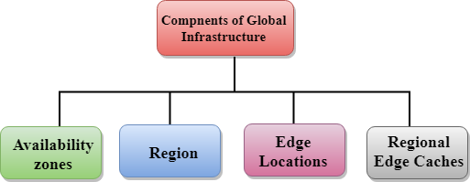
AWS Global Infrastructure
AWS is a cloud computing platform which is globally available.
Global infrastructure is a region around the world in which AWS is based. Global infrastructure is a bunch of high-level IT services.
The AWS Cloud spans 84 Availability Zones within 26 geographic regions around the world, with announced plans for 24 more Availability Zones and 8 more AWS Regions in Australia, India, Indonesia, Israel, New Zealand, Spain, Switzerland, and United Arab Emirates (UAE).
The following are the components that make up the AWS infrastructure:
Availability Zones
Region
Edge locations
Regional Edge Caches

Slide 5
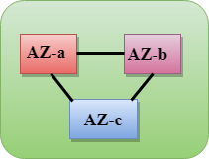
Availability zone as a Data Center
An availability zone is a facility that can be somewhere in a country or in a city. Inside this facility, i.e., Data Centre, we can have multiple servers, switches, load balancing, firewalls. The things which interact with the cloud sits inside the data centers.
An availability zone can be a several data centers, but if they are close together, they are counted as 1 availability zone.
Region
A region is a geographical area. Each region consists of 2 more availability zones.
A region is a collection of data centers which are completely isolated from other regions.
A region consists of more than two availability zones connected to each other through links.
Availability zones are connected through redundant and isolated metro fibers.

Slide 6
What is IAM?
IAM stands for Identity Access Management.
IAM allows you to manage users and their level of access to the aws console.
It is used to set users, permissions and roles. It allows you to grant access to the different parts of the aws platform.
AWS Identity and Access Management is a web service that enables Amazon Web Services (AWS) customers to manage users and user permissions in AWS.
With IAM, Organizations can centrally manage users, security credentials such as access keys, and permissions that control which AWS resources users can access.
Without IAM, Organizations with multiple users must either create multiple user accounts, each with its own billing and subscriptions to AWS products or share an account with a single security credential. Without IAM, you also don't have control about the tasks that the users can do.
IAM enables the organization to create multiple users, each with its own security credentials, controlled and billed to a single aws account. IAM allows the user to do only what they need to do as a part of the user's job.

Slide 7
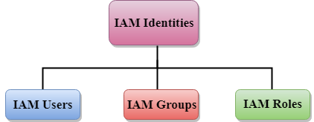
IAM Identities
IAM identities are created to provide authentication for people and processes in your aws account.
AWS Account Root User
When you first create an AWS account, you create an account as a root user identity which is used to sign in to AWS.
You can sign to the AWS Management Console by entering your email address and password. The combination of email address and password is known as root user credentials.
When you sign in to AWS account as a root user, you have unrestricted access to all the resources in AWS account.
The Root user can also access the billing information as well as can change the password also.

Slide 8
IAM Users
An IAM User is an entity created in AWS that provides a way to interact with AWS resources.
The main purpose of IAM Users is that they can sign in to the AWS Management Console and can make requests to the AWS services.
An advantage of using individual IAM Users is that you can assign the permissions individually. You can even assign the administrative permissions, who can administer your AWS resources and also administer other IAM Users.
Mainly, the user's permissions are set to AWS tasks and resources, i.e., the job assigned to the IAM User. For example, you create an IAM User whose name is Advita, you create a password for the user and set the permissions that let her start Amazon EC2 instances and read the data from Amazon RDS database.
Each IAM User is associated with one and only one AWS account.
Users are defined within your account, so users do not have to do payment. Any AWS activity performed by a user is billed to your account.
IAM Users Aren't Necessarily People
An IAM User doesn't necessarily represent a people. An IAM User is just an identity with associated permission. You can also create an IAM User to represent an application that needs to have credentials in order to access the AWS services.

Slide 9
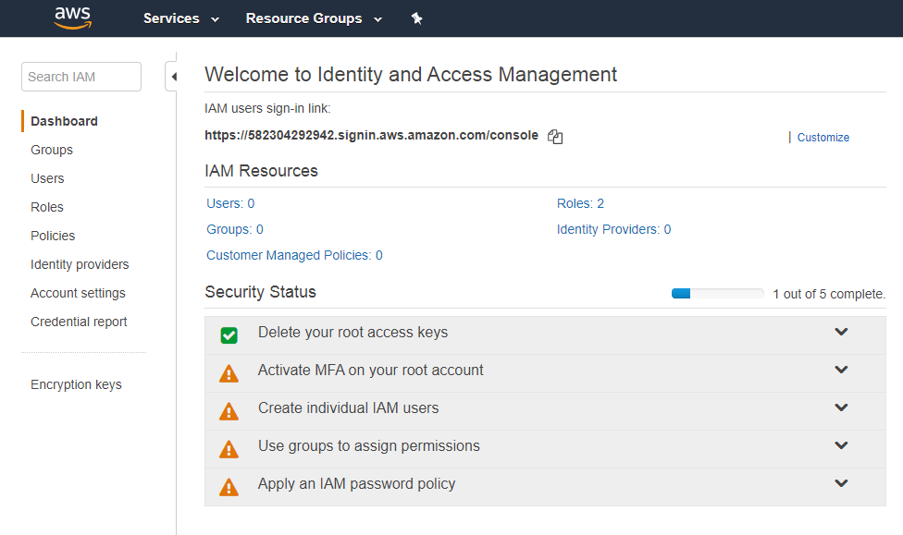

Slide 10
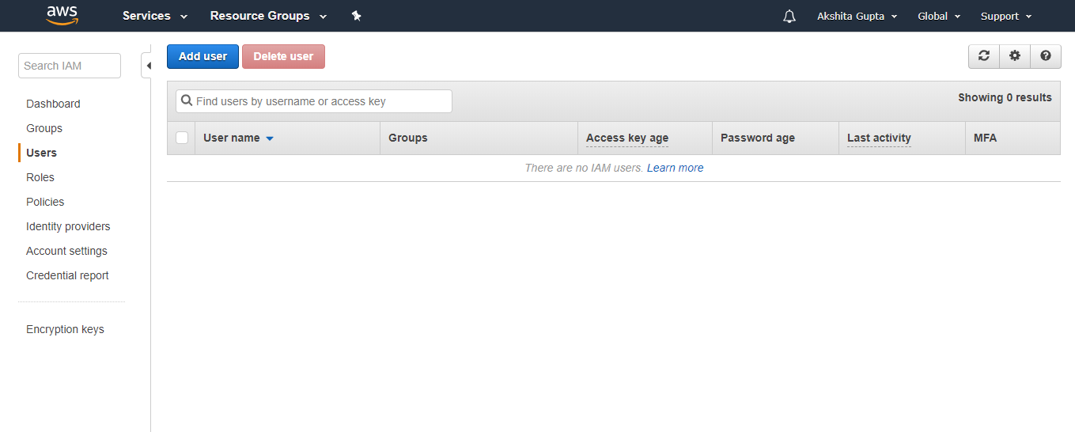
Click on the Add User to add new users to your account. After clicking on the Add User, the screen appears which is shown below:

Slide 11
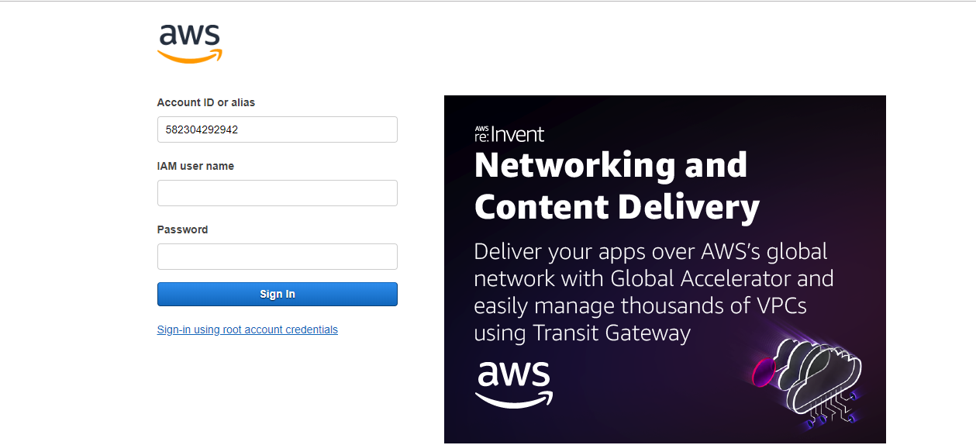

Slide 12
IAM Groups
An IAM Group is a collection of users.
Group specifies the permission for a collection of users, and it also makes it possible to manage the permissions easily for those users.
You created a group known as Admin and assigned the permissions to the group that administrators typically need. Any user joins the admin group; then the user will have all the permissions that are assigned to the group. If a new user joins the organization, then he should have administrator privileges, and you can assign the appropriate permissions by adding him to the group. If a person changes his job profile, instead of editing his permissions, you can remove him from a group and add him to the group.

Slide 13
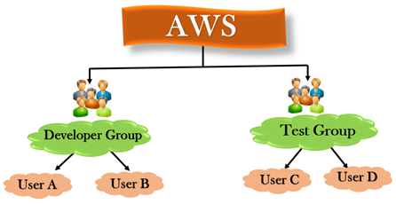
Characteristics of IAM Group
A group is a collection of users, and a user can also belong to multiple groups.
Groups cannot be nested, i.e., a group cannot contain another group.
No default group that automatically includes all the users in AWS account. If you want a group like this, create a group and then add the users in a group.
There is a limit to the number of groups that you can have and also have a limit to the number of groups that a user can belong to.
You can have up to 300 IAM groups per account.

Slide 14
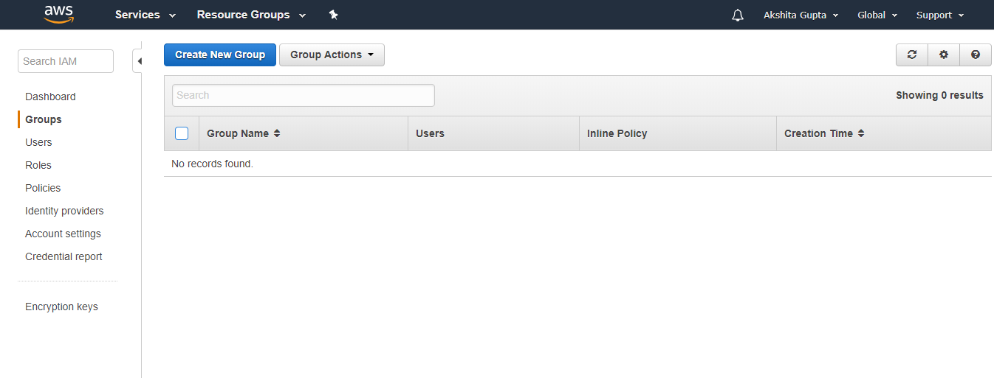
Creating a Group (AWS Management Console)
Sign in to the AWS Management Console by entering your email address and password.
Open IAM Console
In the navigation pane, click on the Groups. After clicking on the Group, the screen appears which is shown below:

Slide 15
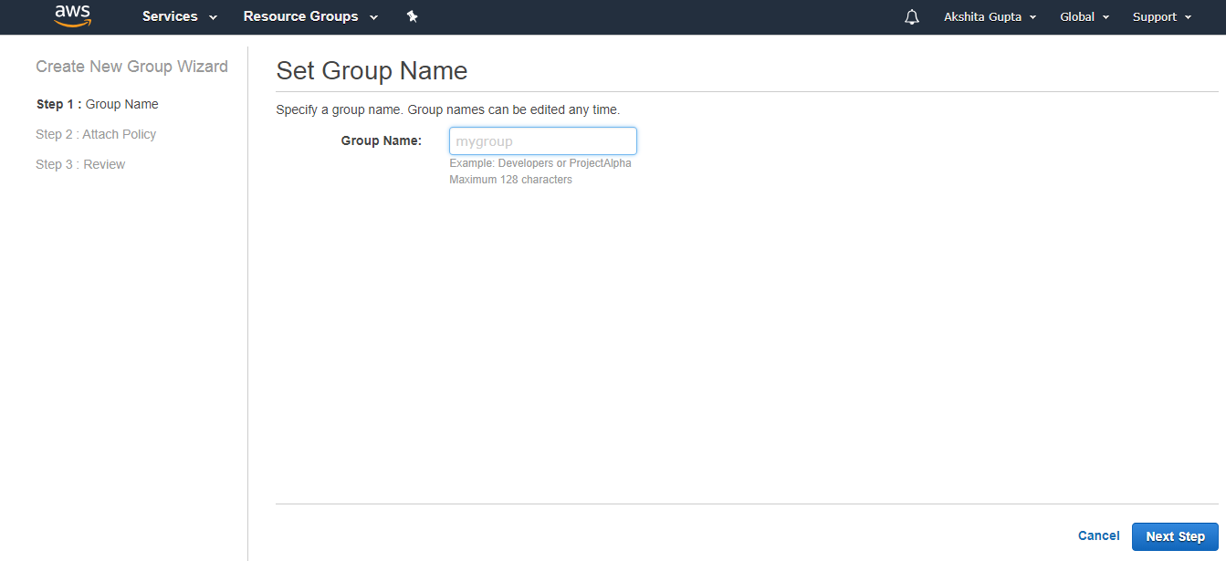
In the Group Name box, enter the group name and then click on the Next Step button.
Select the checkbox next to the policy which you want to use with the group.
Click on the Next Step button and then click on the Create Group.

Slide 16
What is a Role?
A role is a set of permissions that grant access to actions and resources in AWS. These permissions are attached to the role, not to an IAM User or a group.
An IAM User can use a role in the same AWS account or a different account.
Role is also an AWS identity with permission policies that determine what the identity can and cannot do in AWS.
A role is not uniquely associated with a single person; it can be used by anyone who needs it.
A role does not have long term security credential, i.e., password or security key. Instead, if the user uses a role, temporarily security credentials are created and provided to the user.
You can use the roles to delegate access to users, applications or services that generally do not have access to your AWS resources.

Slide 17
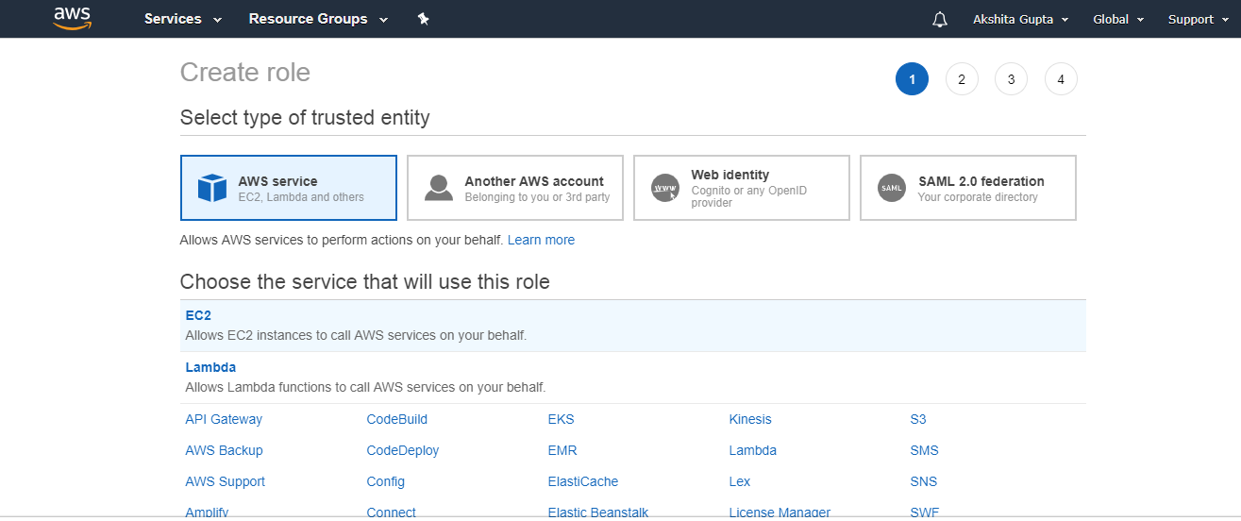
Creating IAM Roles for a service
Creating a Role for a service using the AWS Management Console.
In the navigation pane of the console, click Roles and then click on "Create Role". The screen appears shown below on clicking Create Role button.

Slide 18
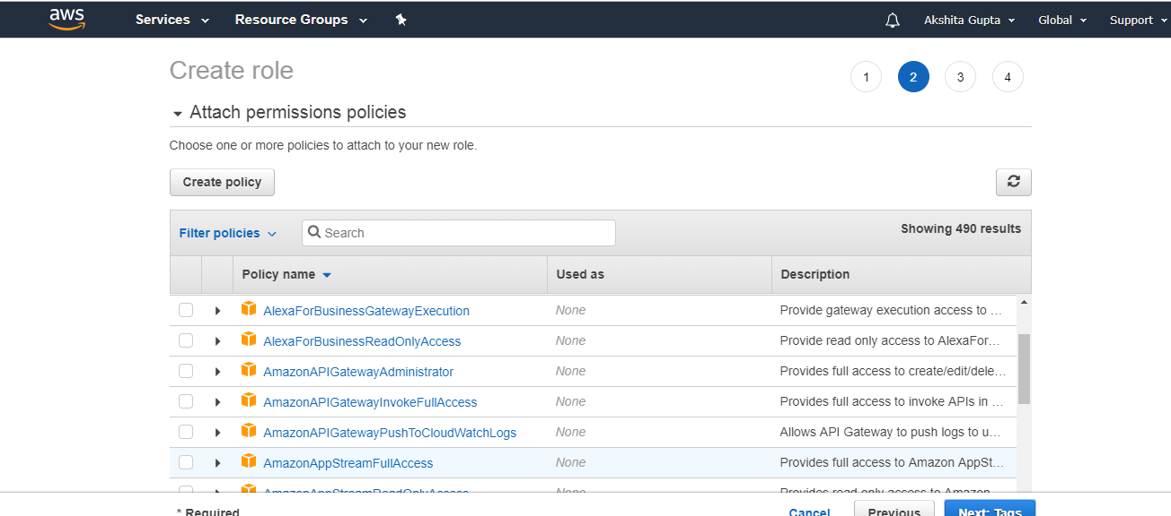
Choose the service that you want to use with the role.
Select the managed policy that attaches the permissions to the service.

Slide 19
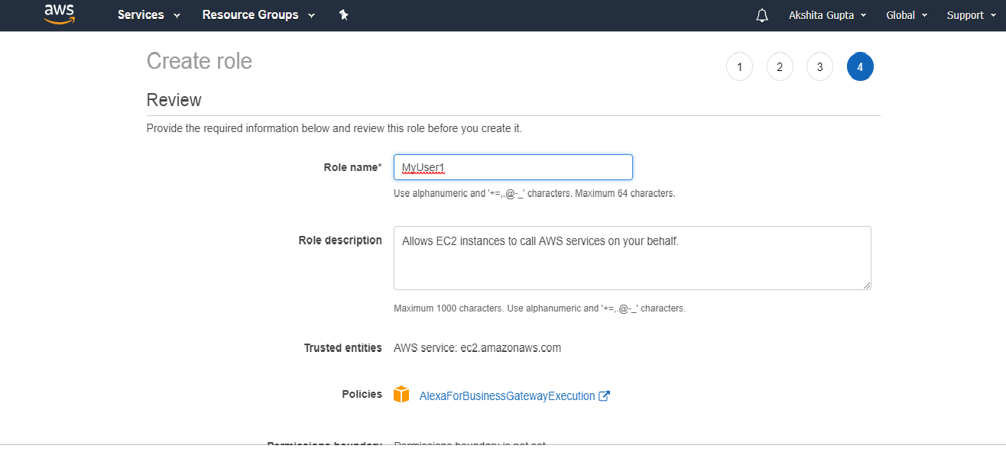
In a role name box, enter the role name that describes the role of the service, and then click on "Create role".

Slide 20
What is S3?
S3 is one of the first services that has been produced by aws.
S3 stands for Simple Storage Service.
S3 provides developers and IT teams with secure, durable, highly scalable object storage.
It is easy to use with a simple web services interface to store and retrieve any amount of data from anywhere on the web.
S3 is a safe place to store the files.
It is Object-based storage, i.e., you can store the images, word files, pdf files, etc.
The files which are stored in S3 can be from 0 Bytes to 5 TB.
It has unlimited storage means that you can store the data as much you want.
Files are stored in Bucket. A bucket is like a folder available in S3 that stores the files.
S3 is a universal namespace, i.e., the names must be unique globally. Bucket contains a DNS address. Therefore, the bucket must contain a unique name to generate a unique DNS address.

Slide 21
Buckets
A bucket is a container used for storing the objects.
Every object is incorporated in a bucket.
For example, if the object named photos/tree.jpg is stored in the treeimage bucket, then it can be addressed by using the URL http://treeimage.s3.amazonaws.com/photos/tree.jpg.
A bucket has no limit to the amount of objects that it can store. No bucket can exist inside of other buckets.
S3 performance remains the same regardless of how many buckets have been created.
The AWS user that creates a bucket owns it, and no other AWS user cannot own it. Therefore, we can say that the ownership of a bucket is not transferrable.
The AWS account that creates a bucket can delete a bucket, but no other AWS user can delete the bucket.

Slide 22
Objects
Objects are the entities which are stored in an S3 bucket.
An object consists of object data and metadata where metadata is a set of name-value pair that describes the data.
An object consists of some default metadata such as date last modified, and standard HTTP metadata, such as Content type.
It is uniquely identified within a bucket by key and version ID.
Key
A key is a unique identifier for an object.
Every object in a bucket is associated with one key.
An object can be uniquely identified by using a combination of bucket name, the key, and optionally version ID.
For example, in the URL http://jtp.s3.amazonaws.com/2019-01-31/Amazons3.wsdl where "jtp" is the bucket name, and key is "2019-01-31/Amazons3.wsdl"

Slide 23
Regions
You can choose a geographical region in which you want to store the buckets that you have created.
A region is chosen in such a way that it optimizes the latency, minimize costs or address regulatory requirements.
Objects will not leave the region unless you explicitly transfer the objects to another region.

Slide 24
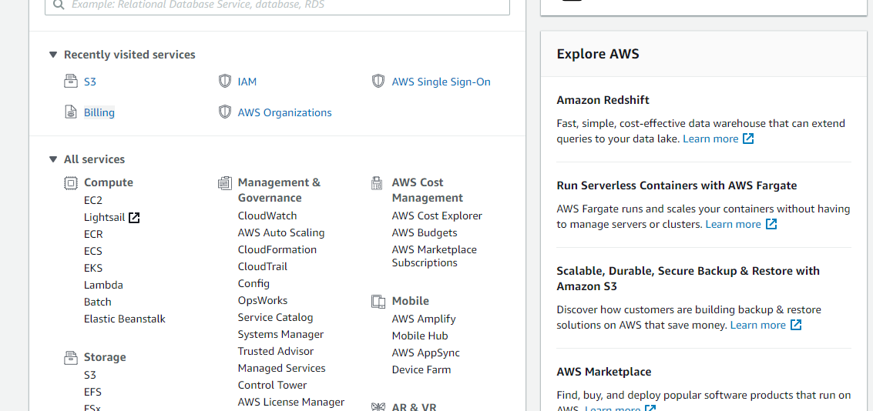
Creating an S3 Bucket
Sign in to the AWS Management console. After sign in, the screen appears is shown below:
Move to the S3 services. After clicking on S3, the screen appears is shown below:

Slide 25
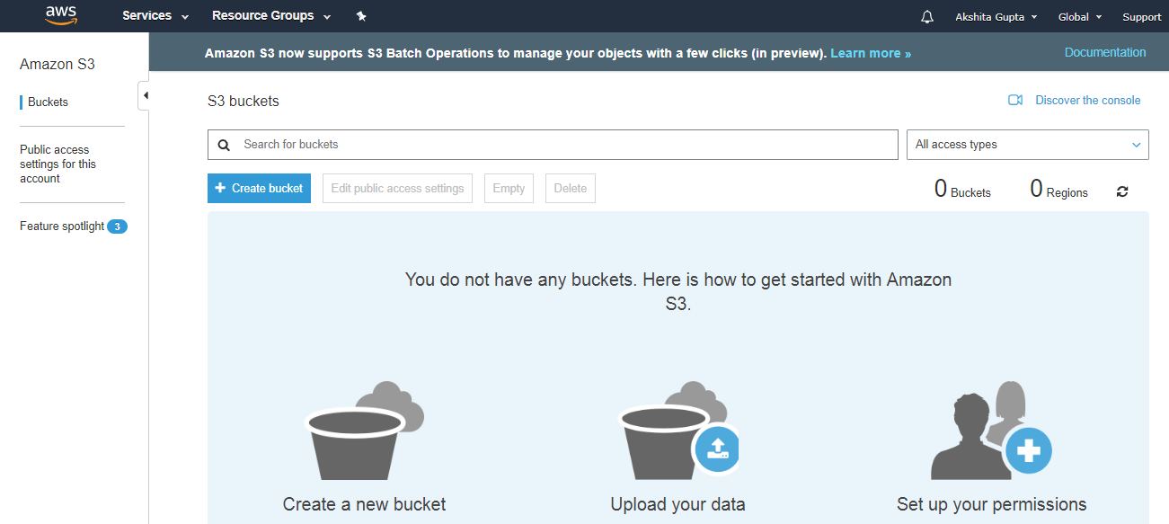

Slide 26
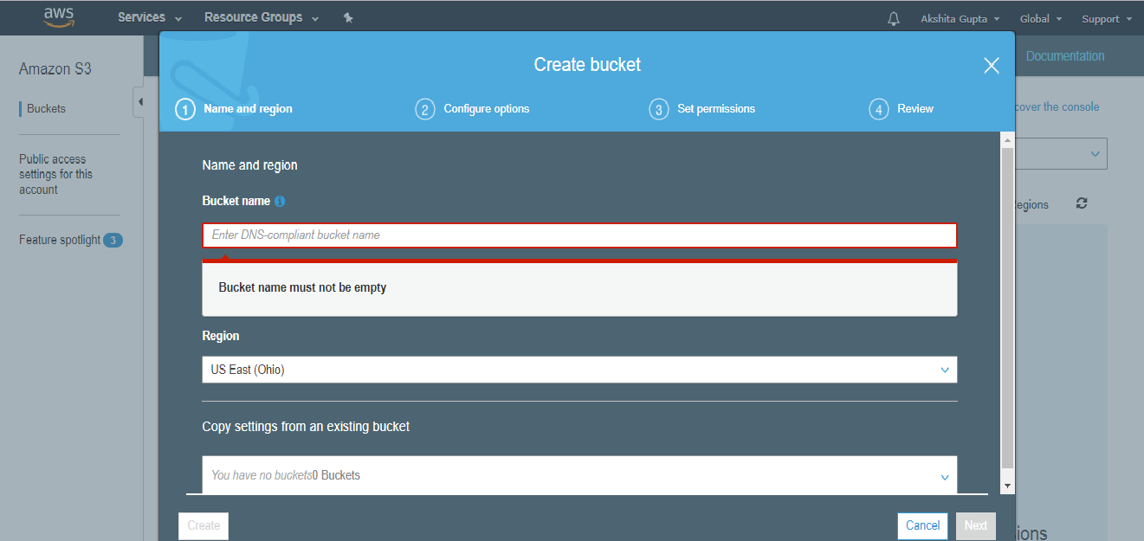

Slide 27
EC2
EC2 stands for Amazon Elastic Compute Cloud.
Amazon EC2 is a web service that provides resizable compute capacity in the cloud.
Amazon EC2 reduces the time required to obtain and boot new user instances to minutes rather than in older days, if you need a server then you had to put a purchase order, and cabling is done to get a new server which is a very time-consuming process. Now, Amazon has provided an EC2 which is a virtual machine in the cloud that completely changes the industry.
You can scale the compute capacity up and down as per the computing requirement changes.
Amazon EC2 changes the economics of computing by allowing you to pay only for the resources that you actually use. Rather than you previously buy physical servers, you would look for a server that has more CPU capacity, RAM capacity and you buy a server over 5 year term, so you have to plan for 5 years in advance. People spend a lot of capital in such investments. EC2 allows you to pay for the capacity that you actually use.
Amazon EC2 provides the developers with the tools to build resilient applications that isolate themselves from some common scenarios.

Slide 28
What is Lambda?
Lambda is used to encapsulate Data centres, Hardware, Assembly code/Protocols, high-level languages, operating systems, AWS APIs.
Lambda is a compute service where you can upload your code and create the Lambda function.
Lambda takes care of provisioning and managing the servers used to run the code.
While using Lambda, you don't have to worry about scaling, patching, operating systems, etc.
Lambda can be used in the following ways:
It can be used as an event-driven compute service where AWS Lambda runs your code in response to events. These events could be changes to data in an Amazon S3 bucket.
It can be used as a compute service to run your code in response to HTTP requests using Amazon API calls made using AWS SDKs.

Slide 29
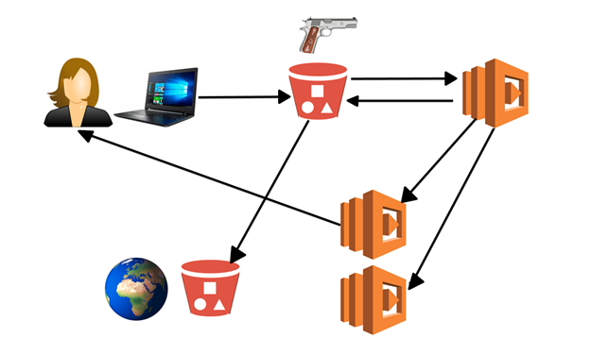
How does Lambda work
User uploads an image to S3.
S3 triggers an event, and this event is a Lambda function.
Lambda function takes this image, and then encode the image. When an image is encoded, it gets stored in S3.
The Lambda function might trigger other Lambda event which is returning image location back to the user.
The Lambda might trigger another Lambda event that takes the image from the S3 bucket and stores it in another S3 bucket located anywhere in the world.

Slide 30
Conclusion
From the above example, we conclude that Lambda event can trigger another Lambda event and they can communicate with other AWS resources.
An important feature of Lambda is that it scales automatically. While using Lambda, you do not have to maintain Elastic Load Balancer. It either scales up or scales out based on the condition. Scaling up means increasing the resources in terms of RAM such as 8 GB to 12 GB. Scaling out means adding more and more instances. For example, Load Balancer. If load increases, you scale out rather than scaling up the instances. Lambda function scales out automatically. For example, if we have a two-line function, and millions of users hit the same function, millions of functions created to serve the millions of users.

Slide 31
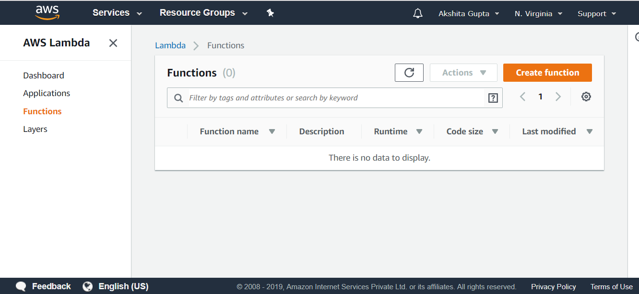
How to create a Lambda function
Sign in to the AWS Management Console.
Click on the Lambda service.
Select the Northern Virginia region as it contains almost all AWS resources.
Click on the Function appearing on the left side of the console.

Slide 32
AWS Glue
Aws Glue is a managed service by AWS
AWS Glue is a contended, cost-effective ETL (extract, transform, and load) service used to clean, enhance, categorize, and move the data securely among the data streams and stores.
AWS Glue acts as a center of metadata repository called AWS Glue Data Catalog, a flexible scheduler to handle dependency resolution (dependent sequence of Jobs), data retrieval, and job monitoring, an ETL engine to automatically generate Python or Scala code.
As the AWS Glue is serverless, there is no need to set up or manage infrastructure.
Serverless
Components of AWS Glue
AWS Glue Data Catalog
The data catalog acts as a central metadata storehouse by creating tables to store the metadata information. Every table in this AWS Glue Data Catalog points to a single data store. Precisely, it acts as an index to the schema storing runtime metrics and location, which are very helpful in identifying the sources and targets of the ETL jobs
Job Scheduling System
This system automates and binds the ETL pipelines. The AWS Glue Job Scheduling System plays a crucial role as it maintains the timing in the system. The scheduler is flexible and can set up triggers based on the events and job execution.
ETL Engine
The component of AWS Glue that addresses the code generation is the ETL engine. The code is automatically presented in Python or Scala, and it is open code allowing the users to customize the code.

Slide 33
Key Features
The resources are automated to scale the current needs of the situation.
Schedules, specific events, or triggers decide the execution of ETL jobs.
The changes made to the database schema and services are easily recognized for quick response.
Metrics, Logs of ETL procedures, and KPIs (Key Performance Indicators) are reported and monitored by AWS Glue.
Metadata and the data sources are securely archived in AWS Glue Data Catalog.
AWS Glue handles the errors with the error handling mechanism and resolves a pile-up of issues.
ETL scripts are generated for a rich experience when data is transferred from source to target.
AWS Glue Terminology
Classifier
Classifier provides information on the schema, i.e., description of the data. File types such as CSV, XML, JSON, etc., have different classifiers provided by AWS Glue.
Database
The database collects data in tables from various sources, and the tables are arranged in separate categories.
Crawler
The AWS Glue Data Catalog is filled in with metadata using a crawler. The filling is done by pointing the crawler at a data store in the data catalog. Crawlers can turn the semi-structured data into a relational schema.

Slide 34
Data Target, Data Source / Data Store
Data Source is used as input data for transformations. This transformed data is written to a Data Target.
Dynamic Frame
The limitations of Frames in Apache Spark are subdued by the Dynamic Frames used in AWS Glue. Each record describes itself and undergoes advanced transformation operations for ETL and data cleaning. Dynamic Frame can also be converted to Data Frame and reversed.
Script
The data is extracted, worked upon, inserted into data target, and stored from various data sources using the scripts like Python and Scala.
Job
ETL (Extract, Transform, Load) scripts create a job. Time intervals can be scheduled to run the assignments, and also sometimes, the jobs are run on demand.
Table
Tables contain the definition of the data and can be in any form, i.e., a file like S3 files or a service like an amazon RD service.

Slide 35
AWS Glue vs Lambda?
Lambda runs faster for smaller loads, whereas Glue runs faster for larger workloads.
Various languages, such as Go, Java, Node.js, Python, etc., are used by Lambda to execute jobs, whereas AWS Glue can only use Python or Scala code.
The run time of Lambda is very low for smaller tasks, and the initialization of Glue jobs requires more extended time for its distributed processing.
Triggers execute code in Lambda from other services like S3., whereas Glue code is executed and triggered by lambda events, manually or through scheduling the events.
Lambda needs complex coding to integrate data sources. Glue can easily be combined with any of the sources.
Glue has additional components such as a scheduler to handle the job execution time, Data Catalog, which acts as a store, unlike Lambda.

Slide 36
The significant benefits of AWS Glue are
Cost-Effective
Less Hassle
Proper scheduling of Job
Serverless
Raised visibility of data
Pay-as-per-usage
Automatic ETL functioning

Slide 37
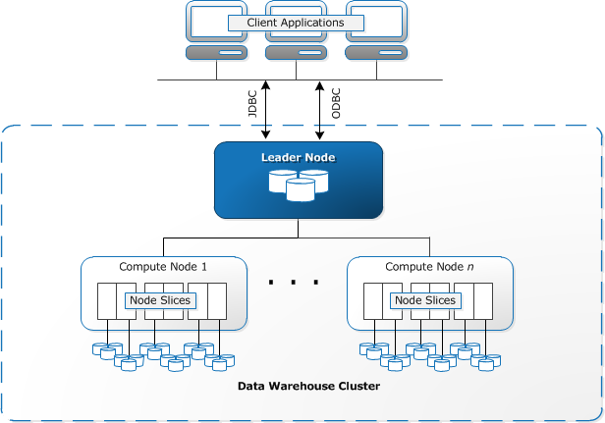
What is Redshift?
Redshift is a fast and powerful, fully managed, petabyte-scale data warehouse service in the cloud.
Customers can use the Redshift for just $0.25 per hour with no commitments or upfront costs and scale to a petabyte or more for $1,000 per terabyte per year.

Slide 38
Amazon Redshift is specifically designed for online analytic processing (OLAP) and business intelligence (BI) applications, which require complex queries against large datasets.
Amazon Redshift is based on industry-standard PostgreSQL, so most existing SQL client applications will work with only minimal changes.
Because it addresses very different requirements, the specialized data storage schema and query execution engine that Amazon Redshift uses are completely different from the PostgreSQL implementation. For example, where online transaction processing (OLTP) applications typically store data in rows, Amazon Redshift stores data in columns, using specialized data compression encodings for optimum memory usage and disk I/O. Some PostgreSQL features that are suited to smaller-scale OLTP processing, have been omitted to improve performance.
Leader node
The leader node manages communications with client programs and all communication with compute nodes. It parses and develops execution plans to carry out database operations, in particular, the series of steps necessary to obtain results for complex queries. Based on the execution plan, the leader node compiles code, distributes the compiled code to the compute nodes, and assigns a portion of the data to each compute node. The leader node distributes SQL statements to the compute nodes only when a query references tables that are stored on the compute nodes. All other queries run exclusively on the leader node.

Slide 39
Compute nodes
The leader node compiles code for individual elements of the execution plan and assigns the code to individual compute nodes. The compute nodes runs the compiled code and send intermediate results back to the leader node for final aggregation. Each compute node has its own dedicated CPU, memory, and attached disk storage, which are determined by the node type. As your workload grows, you can increase the compute capacity and storage capacity of a cluster by increasing the number of nodes, upgrading the node type, or both.
Node slices
A compute node is partitioned into slices. Each slice is allocated a portion of the node's memory and disk space, where it processes a portion of the workload assigned to the node. The leader node manages distributing data to the slices and apportions the workload for any queries or other database operations to the slices. The slices then work in parallel to complete the operation. The number of slices per node is determined by the node size of the cluster.

Slide 40
Why Redshift is faster
Columnar Data Storage
Instead of storing data as a series of rows, Amazon Redshift organizes the data by column. Row-based systems are ideal for transaction processing while column-based systems are ideal for data warehousing and analytics, where queries often involve aggregates performed over large data sets. Since only the columns involved in the queries are processed and columnar data is stored in a storage media sequentially, column-based systems require fewer I/Os, thus, improving query performance.
Advanced Compression
Columnar data stores can be compressed much more than row-based data stores because similar data is stored sequentially on disk. Amazon Redshift employs multiple compression techniques and can often achieve significant compression relative to traditional relation data stores. Amazon Redshift does not require indexes or materialized views so, it requires less space than traditional relational database systems. When loading a data into an empty table, Amazon Redshift samples your data automatically and selects the most appropriate compression technique.
Massively Parallel Processing
Amazon Redshift automatically distributes the data and loads the query across various nodes. An Amazon Redshift makes it easy to add new nodes to your data warehouse, and this allows us to achieve faster query performance as your data warehouse grows.

Slide 41
Distribution styles
When you create a table, you can designate one of four distribution styles; AUTO, EVEN, KEY, or ALL. If you don't specify a distribution style, Amazon Redshift uses AUTO distribution.
EVEN distribution
The leader node distributes the rows across the slices in a round-robin fashion, regardless of the values in any particular column. EVEN distribution is appropriate when a table doesn't participate in joins. It's also appropriate when there isn't a clear choice between KEY distribution and ALL distribution.
KEY distribution
The rows are distributed according to the values in one column. The leader node places matching values on the same node slice. If you distribute a pair of tables on the joining keys, the leader node collocates the rows on the slices according to the values in the joining columns. This way, matching values from the common columns are physically stored together.

Slide 42
ALL distribution
A copy of the entire table is distributed to every node. Where EVEN distribution or KEY distribution place only a portion of a table's rows on each node, ALL distribution ensures that every row is collocated for every join that the table participates in. ALL distribution multiplies the storage required by the number of nodes in the cluster, and so it takes much longer to load, update, or insert data into multiple tables. ALL distribution is appropriate only for relatively slow moving tables; that is, tables that are not updated frequently or extensively.
AUTO distribution
With AUTO distribution, Amazon Redshift assigns an optimal distribution style based on the size of the table data. For example, Amazon Redshift initially assigns ALL distribution to a small table, then changes to EVEN distribution when the table grows larger. When a table is changed from ALL to EVEN distribution, storage utilization might change slightly. The change in distribution occurs in the background, in a few seconds.
When you set DISTSTYLE to AUTO, Amazon Redshift might change the distribution of your table data to have a KEY-based distribution style.

Slide 43
sort keys :
When you create a table, you can alternatively define one or more of its columns as sort keys. When data is initially loaded into the empty table, the rows are stored on disk in sorted order. Information about sort key columns is passed to the query planner, and the planner uses this information to construct plans that exploit the way that the data is sorted.
Sorting enables efficient handling of range-restricted predicates. Amazon Redshift stores columnar data in 1 MB disk blocks. The min and max values for each block are stored as part of the metadata. If a query uses a range-restricted predicate, the query processor can use the min and max values to rapidly skip over large numbers of blocks during table scans
For example, suppose that a table stores five years of data sorted by date and a query specifies a date range of one month. In this case, you can eliminate up to 98 percent of the disk blocks from the scan. If the data is not sorted, more of the disk blocks (possibly all of them) have to be scanned
You can specify either a compound or interleaved sort key. A compound sort key is more efficient when query predicates use a prefix, which is a subset of the sort key columns in order. An interleaved sort key gives equal weight to each column in the sort key, so query predicates can use any subset of the columns that make up the sort key, in any order..

Slide 44
You can define a maximum of 400 COMPOUND SORTKEY columns or 8 INTERLEAVED SORTKEY columns per table.
AUTO
Specifies that Amazon Redshift assigns an optimal sort key based on the table data. For example, if AUTO sort key is specified, Amazon Redshift initially assigns no sort key to a table. If Amazon Redshift determines that a sort key will improve the performance of queries, then Amazon Redshift might change the sort key of your table. The actual sorting of the table is done by automatic table sort.
COMPOUND
Specifies that the data is sorted using a compound key made up of all of the listed columns, in the order they are listed. A compound sort key is most useful when a query scans rows according to the order of the sort columns. The performance benefits of sorting with a compound key decrease when queries rely on secondary sort columns
INTERLEAVED
An interleaved sort gives equal weight to each column, or subset of columns, in the sort key, so queries don't depend on the order of the columns in the sort key. When a query uses one or more secondary sort columns, interleaved sorting significantly improves query performance. Interleaved sorting carries a small overhead cost for data loading

Slide 45
CREATE TABLE employees
(
employee_id integer(30),
first_name varchar(30) default 'John',
last_name varchar(30) default 'Doe',
email varchar(60) default 'john.doe@xyz.com',
phone varchar(15) default '000-000-0000',
hire_date date default '1901-01-01',
sales_id integer default 0
);

Slide 46
Create Table With Distribution
In Redshift, Distribution style defines how data is allocated across the compute nodes in a cluster. Data distribution across the compute nodes plays a key role in determining storage utilization, query and overall system performance.
Redshift has 4 data distribution styles: AUTO, EVEN, KEY and ALL.
AUTO is the default distribution style in Redshift. When the distribution style is set to AUTO, Redshift assigns EVEN or ALL depending on the table data size.
In EVEN distribution, rows are distributed across the node slices in a round robin fashion. Use EVEN if you do not plan on joining tables.
In a KEY distribution style, one of the columns in the table is set as the distribution key (DISTKEY). The rows in the table are then distributed based on this column. Key distribution is great if you plan on joining tables.
In an ALL distribution style, all rows of a table are copied to every single compute node. ALL distribution increases the storage requirements for a table, and also slows down DML queries. The best use case for an ALL distribution style is when tables are not updated frequently.

Slide 47
AUTO distribution
CREATE TABLE employees
(
employee_id int(30) sortkey,
first_name varchar(30) default 'John',
last_name varchar(30) default 'Doe',
email varchar(60) default 'john.doe@xyz.com',
phone varchar(15) default '000-000-0000',
hire_date date default '1901-01-01',
sales_id integer default 0
) diststyle AUTO;

Slide 48
EVEN distribution
CREATE TABLE employees
(
employee_id int(30) identity(0,1),
first_name varchar(30) default 'John',
last_name varchar(30) default 'Doe',
email varchar(60) default 'john.doe@xyz.com',
phone varchar(15) default '000-000-0000',
hire_date date default '1901-01-01',
sales_id integer default 0
) diststyle EVEN;

Slide 49
KEY distribution
CREATE TABLE employees
(
employee_id int(30) identity(0,1),
first_name varchar(30) default 'John',
last_name varchar(30) default 'Doe',
email varchar(60) default 'john.doe@xyz.com',
phone varchar(15) default '000-000-0000',
hire_date date default '1901-01-01',
sales_id integer distkey
) diststyle KEY;

Slide 50
ALL distribution
CREATE TABLE employees
(
employee_id int(30) identity(0,1),
first_name varchar(30) default 'John',
last_name varchar(30) default 'Doe',
email varchar(60) default 'john.doe@xyz.com',
phone varchar(15) default '000-000-0000',
hire_date date default '1901-01-01',
sales_id integer default 0
) diststyle ALL;

Slide 51
Create Table with PRIMARY KEY
Redshift Primary Key uniquely identifies all the records in a relational database. In a Redshift table, Primary Key constraints are for informational purposes only; they are not enforced.
Primary Key constraints can be set at the column level or at the table level. If you need a single column to be set as a Primary Key, then set it at the column level. On the other hand, if you need multiple columns to form a composite Primary Key, set it at the table level.
PRIMARY Key - Column level
CREATE TABLE employees
(
employee_id int(30) PRIMARY KEY,
first_name varchar(30) default 'John',
last_name varchar(30) default 'Doe',
email varchar(60) default 'john.doe@xyz.com',
phone varchar(15) default '000-000-0000',
hire_date date default '1901-01-01',
sales_id integer default 0
);

Slide 52
PRIMARY KEY - Table level
CREATE TABLE employees
(
employee_id int(30),
first_name varchar(30) default 'John',
last_name varchar(30) default 'Doe',
email varchar(60) default 'john.doe@xyz.com',
phone varchar(15) default '000-000-0000',
hire_date date default '1901-01-01',
sales_id integer default 0,
primary key (last_name,hire_date)
);

Slide 53
COPY
Loads data into a table from data files or from an Amazon DynamoDB table. The files can be located in an Amazon Simple Storage Service (Amazon S3) bucket, an Amazon EMR cluster, or a remote host that is accessed using a Secure Shell (SSH) connection.
Amazon Redshift Spectrum external tables are read-only. You can't COPY to an external table.
create table catdemo(catid smallint, catgroup varchar(10), catname varchar(10), catdesc varchar(50));
copy catdemo
from 's3://awssampledbuswest2/tickit/category_pipe.txt'
iam_role 'arn:aws:iam::<aws-account-id>:role/<role-name>'
region 'us-west-2';

Slide 54
The COPY command loads all of the files in the /data/listing/ folder.
copy listing
from 's3://mybucket/data/listing/'
iam_role 'arn:aws:iam::0123456789012:role/MyRedshiftRole';
The following example loads the SALES table with JSON formatted data in an Amazon EMR cluster. COPY loads every file in the myoutput/json/ folder.
copy sales
from 'emr://j-SAMPLE2B500FC/myoutput/json/'
iam_role 'arn:aws:iam::0123456789012:role/MyRedshiftRole'
JSON 's3://mybucket/jsonpaths.txt';

Slide 55
loads pipe-delimited data into the EVENT table and applies the following rule
If pairs of quotation marks are used to surround any character strings, they are removed.
Both empty strings and strings that contain blanks are loaded as NULL values.
The load fails if more than 5 errors are returned.
Timestamp values must comply with the specified format; for example, a valid timestamp is 2008-09-26 05:43:12.
copy event
from 's3://mybucket/data/allevents_pipe.txt'
iam_role 'arn:aws:iam::0123456789012:role/MyRedshiftRole'
removequotes
emptyasnull
blanksasnull
maxerror 5
delimiter '|'
timeformat 'YYYY-MM-DD HH:MI:SS';

Slide 56
Load LISTING using columnar data in Parquet/orc format
copy listing
from 's3://mybucket/data/listings/parquet/'
iam_role 'arn:aws:iam::0123456789012:role/MyRedshiftRole'
format as parquet;
copy listing
from 's3://mybucket/data/listings/orc/'
iam_role 'arn:aws:iam::0123456789012:role/MyRedshiftRole'
format as orc;

Slide 57
pipe-delimited file (default delimiter)
The following example is a very simple case in which no options are specified and the input file contains the default delimiter, a pipe character ('|').
copy listing
from 's3://mybucket/data/listings_pipe.txt'
iam_role 'arn:aws:iam::0123456789012:role/MyRedshiftRole';
Load CATEGORY from a CSV file
copy category
from 's3://mybucket/data/category_csv.txt'
iam_role 'arn:aws:iam::0123456789012:role/MyRedshiftRole'
csv;

Slide 58
UNLOAD
Unload VENUE to a pipe-delimited file (default delimiter)
The following example unloads the VENUE table and writes the data to s3://mybucket/unload/:
unload ('select * from venue')
to 's3://mybucket/unload/'
iam_role 'arn:aws:iam::0123456789012:role/MyRedshiftRole';

Slide 59
Unload LINEITEM table to partitioned Parquet files
unload ('select * from lineitem')
to 's3://mybucket/lineitem/'
iam_role 'arn:aws:iam::0123456789012:role/MyRedshiftRole'
PARQUET
PARTITION BY (l_shipdate);

Slide 60
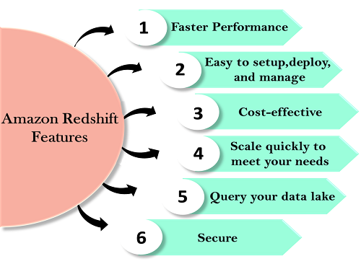
Redshift features

Slide 61
Easy to setup, deploy and manage
Automated Provisioning Redshift is simple to set up and operate. You can deploy a new data warehouse with just a few clicks in the AWS Console, and Redshift automatically provisions the infrastructure for you. In AWS, all the administrative tasks are automated, such as backups and replication, you need to focus on your data, not on the administration.
Automated backups Redshift automatically backups your data to S3. You can also replicate the snapshots in S3 in another region for any disaster recovery.
Cost-effective
No upfront costs, pay as you go Amazon Redshift is the most cost-effective data warehouse service as you need to pay only for what you use. Its costs start with $0.25 per hour with no commitment and no upfront costs and can scale out to $250 per terabyte per year. Amazon Redshift is the only data warehouse service that offers On Demand pricing with no up-front costs, and it also offers Reserved instance pricing that saves up to 75% by providing 1-3 year term.

Slide 62
Choose your node type.
You can choose either of the two nodes to optimize the Redshift.
Dense compute node Dense compute node can create a high-performance data warehouses by using fast CPUs, a large amount of RAM, and solid-state disks.
Dense storage node If you want to reduce the cost, then you can use Dense storage node. It creates a cost-effective data warehouse by using a larger hard disk drive.
Scale quickly to meet your needs.
Petabyte-scale data warehousing Amazon Redshift automatically scales up or down the nodes according to the need changes. With just a few clicks in the AWS Console or a single API call can easily change the number of nodes in a data warehouse.
Exabyte-scale data lake analytics It is a feature of Redshift that allows you to run the queries against exabytes of data in Amazon S3. Amazon S3 is a secure and cost-effective data to store unlimited data in an open format.
Limitless concurrency It is a feature of Redshift means that the multiple queries can access the same data in Amazon S3. It allows you to run the queries across the multiple nodes regardless of the complexity of a query or the amount of data.

Slide 63
Query your data lake Amazon Redshift spectrum is used to query the Amazon S3 data lake without loading data. This provides flexibility by storing the frequently accessed data in Redshift and unstructured or infrequently accessed data in Amazon S3.
Secure With a couple of parameter settings, you can set the Redshift to use SSL to secure your data. You can also enable encryption, all the data written to disk will be encrypted.
Faster performance Amazon Redshift provides columnar data storage, compression, and parallel processing to reduce the amount of I/O needed to perform queries. This improves query performance.

Slide 64
Load data from s3 to redshift
Create schema
create schema test;
Create table in test schema
create table test.users(
userid integer not null distkey sortkey,
username char(8),
firstname varchar(30),
lastname varchar(30),
city varchar(30),
state char(2),
email varchar(100),
phone char(14),
likesports boolean,
liketheatre boolean,
likeconcerts boolean,
likejazz boolean,
likeclassical boolean,
likeopera boolean,
likerock boolean,
likevegas boolean,
likebroadway boolean,
likemusicals boolean);

Slide 65
Copy data from s3 to red-shift
copy test.users from 's3://redshift-bucket/data/allusers_pipe.txt'
iam_role 'arn:aws:iam::123456789012:role/MySpectrumRole'
delimiter '|' region 'ap-east-1';

Slide 66
Redshift Spectrum is a feature of the Amazon Redshift data warehouse. The spectrum allows for fast, complex, and efficient analysis of objects stored in the AWS cloud. The spectrum allows for a seamless analysis since it is directly embedded into the Amazons framework.
Redshift Spectrum reduces the time and effort required to perform analysis on data as it eliminates the requirement to move the stored data from the storage service to a database as it can directly query data inside the s3 bucket.

Slide 67
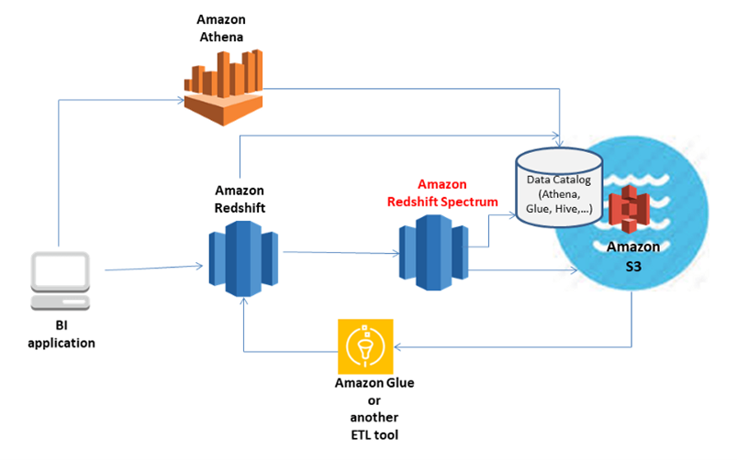

Slide 68
Redshift Spectrum divides user queries into filtered subsets that run concurrently. These requests are distributed across thousands of AWS-managed nodes to maintain query speed and consistent performance. Redshift Spectrum can be scaled to query over exabytes of data, and when S3 data is aggregated, it’s sent back to your on-premises Redshift cluster for final processing.
Features of Redshift Spectrum
Performance: Amazon Redshift Spectrum shows the exceptional performance when querying the data in which it resides. It’s about 10 times faster than other data warehouses. Redshift Spectrum can also speed up data acquisition by setting the capture size according to your data needs.
Ease of Use: Users can easily build and deploy Redshift Spectrum to manage their data needs and execute all complex queries in minutes. You can read the official Redshift Spectrum documentation for ease of setup.
Cheap: Amazon Redshift Spectrum is very beneficial. It’s about 10 times cheaper than a traditional data warehouse. The spectrum is very similar to Amazon Athena and is calculated based on the amount of data scanned.
Highly scalable: Redshift Spectrum is a fully managed platform where all scaling operations are performed directly by Amazon, depending on the amount of data the user scans and queries.
File Format Support: Redshift Spectrum supports complex data files such as JSON, ORC, Parquet, as well as complex data types such as maps, arrays, and structures.

Slide 69
External schema - Create external tables in an external schema. The external schema references a database in the external data catalog and provides the IAM role ARN that authorizes your cluster to access Amazon S3 on your behalf. You can create an external database in an Amazon Athena Data Catalog
create external schema myspectrum_schema
from data catalog
database 'myspectrum_db'
iam_role 'arn:aws:iam::123456789012:role/myspectrum_role'
create external database if not exists;

Slide 70
create external table myspectrum_schema.sales(
salesid integer,
listid integer,
sellerid integer,
buyerid integer,
eventid integer,
dateid smallint,
qtysold smallint,
pricepaid decimal(8,2),
commission decimal(8,2),
saletime timestamp)
row format delimited
fields terminated by '\t'
stored as textfile
location 's3://redshift-downloads/tickit/spectrum/sales/'
table properties ('numRows'='172000');

Slide 71
To query your data in Amazon S3
select count(*) from myspectrum_schema.sales;

Slide 72
Amazon redshift vs Redshift Spectrum
Amazon redshift vs Redshift Spectrum: Use Cases
Amazon redshift is a full-fledged data warehouse that is very efficient in storing raw data and collecting data from various different sources. This tool was designed to ease the process of storage and analytics. redshift supports automated tasks for configuring, monitoring, backing up, and securing the data warehouse.
Redshift Spectrum is the ability to perform analytics directly on the data in the Amazon s3 cluster using a Redshift node. This means that redshift is not independent storage rather it is an advanced analytical tool that works on top of redshift. It offers more functionality and efficiency when compared to the Redshift analytical tool.
Amazon redshift vs Redshift Spectrum are used in different scenarios

Slide 73
Amazon redshift vs Redshift Spectrum: Architecture
Redshift architecture consists of two or more Computing Nodes that are connected to a Leader Node. All the communication between client applications and Cluster only happens through the Leader Node.

Slide 74
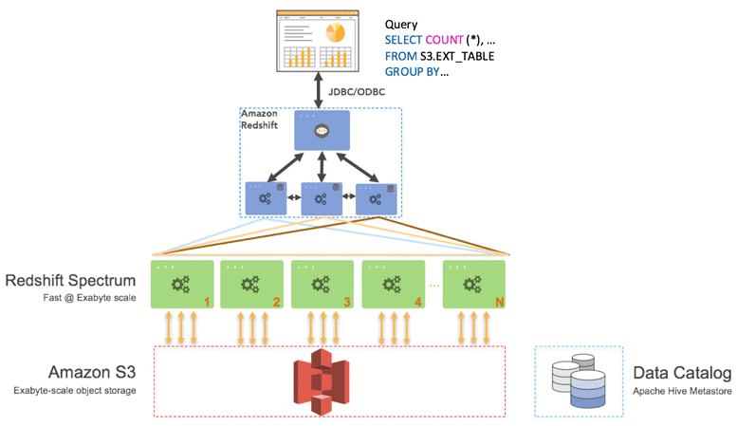
Redshift spectrum works on top of redshift architecture. It is added after the storage Phase. This is clearly depicted in the diagram below.

Slide 75
Amazon redshift vs Redshift Spectrum: Scalability
Redshift is a data warehouse, it supports the influx of large amounts of data, but when comparing the copying property it is very less scalable.
Redshift Spectrum is highly scalable when the data is copied. The scaling operations are directly handled by Amazon, depending upon the amount of data being scanned and queried by the user.
Amazon redshift vs Redshift Spectrum shows the difference in scalabilities.
Amazon redshift vs Redshift Spectrum: Performance
With the use of MPP technology, the speed of delivering output on large data sets is paralleled.
Amazon Redshift Spectrum shows exceptional performance when querying where the data resides. It’s about 10 times faster than other data warehouses. Redshift Spectrum can also speed up data acquisition by setting the capture size according to your data needs

Slide 76
Amazon Athena
Amazon Athena is an interactive data analysis tool used to process complex queries in a relatively short amount of time. It is serverless. Hence, there is no hassle to set up, and no infrastructure management is required. It is not a database service. Therefore, you pay for the queries you run. You just point your data into S3, define the necessary schema, and you are good to go with a standard SQ
Amazon Athena scales automatically, executing queries in parallel, giving fast results even with large datasets and complex queries.
Creating Table in Athena
With the help of glue console
Manual
crawler
External table from athena console

Slide 77
Create external table in athena console.
create external table bootcamp.sales(
salesid integer,
listid integer,
sellerid integer,
buyerid integer,
eventid integer,
dateid smallint,
qtysold smallint,
pricepaid decimal(8,2),
commission decimal(8,2),
saletime timestamp)
row format delimited
fields terminated by '\t'
stored as textfile
location 's3://redshift-bucket/tickit/spectrum/sales/'

Slide 78
Features of Athena
Easy Implementation: Athena does not require installation, and it can also be accessed by the AWS CLI directly from the AWS console.
Serverless: It is serverless, so the end-user does not need to worry about infrastructure, configuration, scaling, or failure. Athena takes care of everything herself.
Pay Per Query: Athena charges you only for the Query you run, i.e., the amount of data managed per Query. You can save a lot if you can compress them and format your dataset accordingly.
Fast: Athena is a very fast analysis tool. It can execute complex queries quickly by breaking them down into simpler queries and running them in parallel, then combining the results to give the desired output.
Secure: With the help of IAM policies and AWS identities, Athena gives you complete control over the data set. Since data is stored in S3 buckets, IAM policies can help you manage users' controls.
Highly Available: With the assurance of AWS, Athena is highly available, and the user can execute queries round the clock. As is AWS 99.999% available, so is Athena.
Integration: The best feature of Athena is that it can be integrated with AWS Glue. AWS Glue will help the user to build a better-integrated data repository. It helps you create better versions of data, better tables, views, etc.

Slide 79
Amazon Redshift Spectrum vs. Athena
At a quick glance, Redshift Spectrum and Athena, both, seem to offer the same functionality - serverless query of data in Amazon S3 using SQL. You don't need to maintain any infrastructure, which makes them incredibly cost-effective. However, the two differ in their functionality. Let's take a closer look at the differences between Amazon Redshift Spectrum and Amazon Athena.
Redshift Spectrum runs in tandem with Amazon Redshift, while Athena is a standalone query engine for querying data stored in Amazon S3
With Redshift Spectrum, you have control over resource provisioning, while in the case of Athena, AWS allocates resources automatically
Performance of Redshift Spectrum depends on your Redshift cluster resources and optimization of S3 storage, while the performance of Athena only depends on S3 optimization
Redshift Spectrum can be more consistent performance-wise while querying in Athena can be slow during peak hours since it runs on pooled resources
Redshift Spectrum is more suitable for running large, complex queries, while Athena is more suited for simplifying interactive queries
Redshift Spectrum needs cluster management, while Athena allows for a truly serverless architecture

Slide 80
AWS Athena vs AWS Glue
Where this turns from AWS Glue vs AWS Athena to AWS Glue working with Athena is with the Glue Catalog. The Glue catalog is used as a central hive-compatible metadata catalog for your data in AWS S3. It can be used across AWS services – Glue ETL, Athena, EMR etc. A key difference between Glue and Athena is that Athena is primarily used as a query tool for analytics and Glue is more of a transformation and data movement tool.

Slide 81
AWS RDS
Amazon RDS is the Relational Database Service offered as a web service by Amazon. It makes it easy to set-up and operate a relational database in the cloud. It provides a very cost-effective way to use industry’s leading RDBMS software as a managed service. Because of this web service from amazon AWS, You do not have to buy any server or install any database software in it. You just have subscribe to the AWS RDS web service and start using the RDBMS features after some initial configuration involving memory and CPU capacity allocation etc.
Amazon RDS currently supports the following engines:
MariaDB
Microsoft SQL Server
MySQL
Oracle
PostgreSQL

